Slide 1
Gradient Boosting
By
Anjali kadre

Slide 2
What is ensemble technique?
Ensemble methods is a machine learning technique that combines several base models in order to produce one optimal predictive model .
Ensemble methods are ideal for regression and classification, where they reduce bias and variance to boost the accuracy of models.

Slide 3
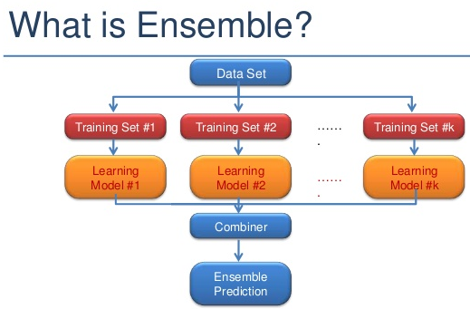

Slide 4
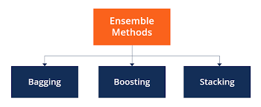
What are the different types of ensemble techniques?

Slide 5
Bagging
Building multiple models (typically of the same type) from different subsamples of the training dataset.
Bagging works as follows:-
Multiple subsets are created from the original dataset, selecting observations with replacement.
A base model (weak model) is created on each of these subsets.
The models run in parallel and are independent of each other.
The final predictions are determined by combining the predictions from all the models.

Slide 6
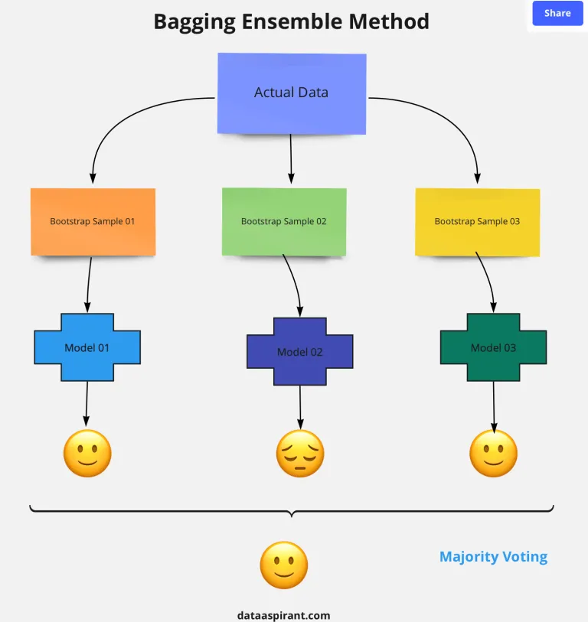

Slide 7
Boosting
In the boosting method, all the individual models are built sequentially. Which means the outcome of the first model passes to the next model and etc.
In bagging the models are built parallel so we don’t know what the error of each model is. Whereas in boosting once the first model built we know the error of that model. So when we pass this first model to the next model the intention is to reduce the error further. In some boosting algorithm, each model has to reduce a minimum of 50% of error.
Suppose we are building a binary classification model. The first model is not accurately predicting the class 01 target, then the input to the second model will get in sequentially way, saying focus more on predicting target class 01.
When selecting the data samples from the bootstrap sample few observations will have high weightage, in this case the data point which can help in accurately predicting the target class 01 will have higher weightage than the other data points.
For the final target, the predictions from all the models will be weighted. Hence the final prediction will be the weighted average.

Slide 8
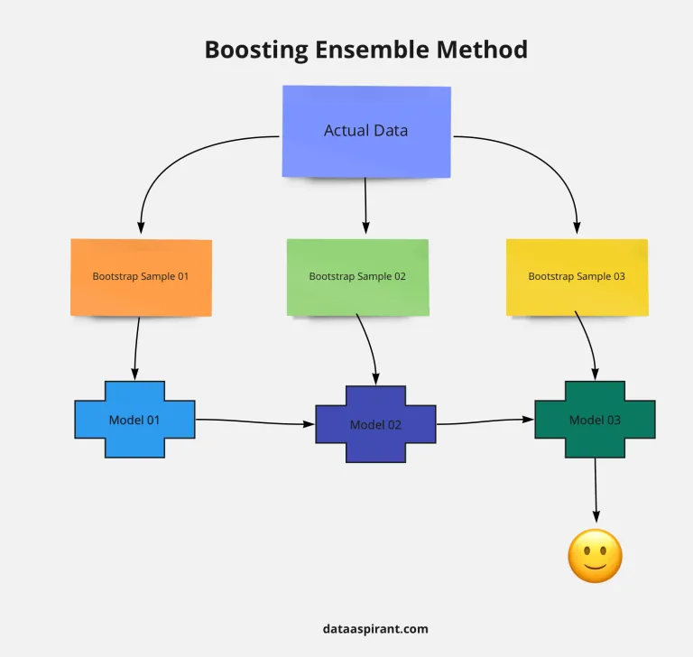

Slide 9
What is gradient Boosting?
The Gradient Boosting Machine is a powerful ensemble machine learning algorithm that uses decision trees.
Boosting is a general ensemble technique that involves sequentially adding models to the ensemble where subsequent models correct the performance of prior models.
Gradient Boosting is an supervised machine learning algorithm used for classification and regression problems.
Gradient Boosting is a popular boosting algorithm. In gradient boosting, each predictor corrects its predecessor’s error.
It is an ensemble technique which uses multiple weak learners to produce a strong model for regression and classification.
Here each predictor is trained using the residual errors of predecessor as labels.

Slide 10
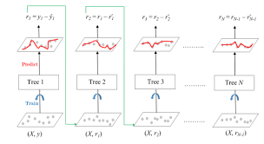

Slide 11
What are the steps of gradient boosting?
Steps:
1. Calculate the average/mean of the target variable.
2. calculate the residuals for each sample.
Residual = Actual Value - Predicted Value
3. use decision tree algorithm to train the model considering residual as label . We build a tree with the goal of predicting the Residuals.
4. Repeat steps 3 to 5 until the number of iterations matches the number specified by the hyper parameter(numbers of estimators)
5. Once trained, use all of the trees in the ensemble to make a final prediction as to value of the target variable.
The final prediction will be equal to the mean we computed in Step 1 plus all the residuals predicted by the trees
that make up the forest multiplied by the learning rate.
final prediction = Average Price + LR*Residual predicted by DT1 + LR*Residual Predicted by DT2 + .......LR*Residual Predicted by DT N
Here,
LR = Learning rate
DT = Decision tree

